Slide 1
File Edit Widget and Word Integration
Background
Business Requirements
Current functionality meeting requirements
The Future

Slide 2
File Edit Widget – What is it?
Allows a user to edit a Microsoft Word document on their local computer and then save it to the IBM Cúram database.
Also an additional feature within the Appeals component which allows a clause to picked and automatically inserted into a Word document.
A document can be created automatically from a template where the template details can be set before the document is presented to the user for editing.
The FILE_EDIT widget uses either a Java applet to manage the interaction between the user's browser and Word (for the browsers which support Java e.g. Internet Explorer) or the Native Messaging API for Chrome.
The customers who use this feature like it. Some of these customers are listed below:
  Alberta
  SAMS
  CPIN
  DSCIS
  Hamburg

Slide 3
File Edit Widget – Recent History
Pre version 6.1 of the product, there were many ongoing issues with this feature.
  Performance issues.
  Instabilities when using COM bridge (findWindows).
  Outdated, for one-windowed/popup based application.
  Multiple APARs from customers which proved difficult to reproduce, diagnose and fix due the number of moving parts within the overall feature (browser version, JRE level, Word version etc.).
Chrome then announced they were dropping NPAPI (Java, applet) support.
  http://blog.chromium.org/2014/11/the-final-countdown-for-npapi.html
After some discussion, this led to the building of a “Chrome specific” solution for the feature (included a stand alone Java process and a Chrome extension).
Also led to re-writing of the infrastructure to support the Java widget for Internet Explorer to ensure it was more stable and that the user experience was better.
Overall, 4-5 months of effort to achieve this.
Now have two separate implementations, one for Chrome and one for Internet Explorer.
The Widget has proved relatively stable since it was re-written/re-factored for the 6.1 release.
There are still some customer cases coming in but not of the same volume as pre the re-write.
There are some still edge case issues such as the Word application is left open when the session is terminated unexpectedly.

Slide 4
File Edit Widget – What is Next?
There have been recent announcements from Microsoft that they are going to follow suit and drop the Java plugin support in their browsers in the future.
Oracle have also announced they are going to drop the browser plug-in support starting with the Java 9 release.
These changes have already begun with the Microsoft Edge browser (Windows 10) dropping support for running Java in the browser (applet support).
  http://answers.microsoft.com/en-us/windows/forum/apps_windows_10-msedge/ms-edge-plugins/eb4e3bed-1a0b-4d95-b437-8fdbb4482691
This change in third party policy by Microsoft means that the current file edit solution will not work on Microsoft Edge (we have ran a quick test and found this to be the case).
In addition to that, Microsoft have not yet proposed any alternative to the old functionality and at this stage, Edge is a complete black box with no allowed interaction.
Currently therefore, we could not, even if we wanted, build a bespoke alternative solution for Edge in a similar fashion to Chrome.
What are the alternatives?
  Drop support for this feature altogether from the product.
  Continue support for the feature in Chrome/IE and just state it will not work in Microsoft Edge.
  Provide an alternative solution to solve the customer’s business use case.
  Download/Upload Word Document using existing widgets.
  Investigate open source alternatives?
Further investment in this feature v the benefits. Discuss?

Slide 5
Support Matrix for File Edit Widget
There are a number of variables to be considered in a support matrix for this feature:
  Cúram version.
  Browser Type and Version.
  JRE Version.
  Two current solutions:
    Java applet and the COM bridge combination for the browsers which support applets (IE)
    Native Messaging Bridge (Chrome Extension + Standalone Java Client) + Modified COM bridge for Chrome.
Some significant events (some past and future) also have to be fed into the support matrix:
  Chrome browser discontinue support for running Java in the browser (Sep, 2015).
  Announcements from Microsoft that they are going to follow suit and drop the Java plugin support in future. Latest browser from Microsoft (Edge) already does this.
  JRE 9.0 – Oracle announce that this version will drop browser plug in support (Sep, 2016).

Slide 6
Support Matrix for File Edit Widget (contd.)
Web Browser | V Pre-6.1 |  | V6.1+ | V7 (JRE 7 & 8) | V7 (JRE 9)
 | Pre Sep-2015 | Post Sep-2015
Chrome | Applet | Applet (pre Chrome 45) Not Supported (Chrome 45 and higher versions) | Applet (pre Chrome 45) Bridge/Extension (Chrome 45 and higher versions) | Applet (pre Chrome 45) Bridge/Extension (Chrome 45 and higher versions) | Not Supported (pre Chrome 45) Bridge/Extension (Chrome 45 and higher versions)
IE | Applet | Applet | Applet | Applet | Not Supported
Edge | N/A | N/A | N/A | Not Supported | Not Supported

Slide 7
152269: As a caseworker, I need to be able to open, view and edit MS Word communications from Cúram Communications pages
Business Requirements
152268: As a caseworker, I need the option to select an MS Word Document based on a template that I can edit
152275: As an Appeals user, I need to be able to search for pre-configured text that I can insert into a new MS Word template
152276: As an Administrator, I need to be able to create standard paragraph text (clauses) that can be used to insert into an MS Word template

Slide 8

How Business Requirements satisfied today, 7.0.1 screenshots on Chrome Browser

Slide 9
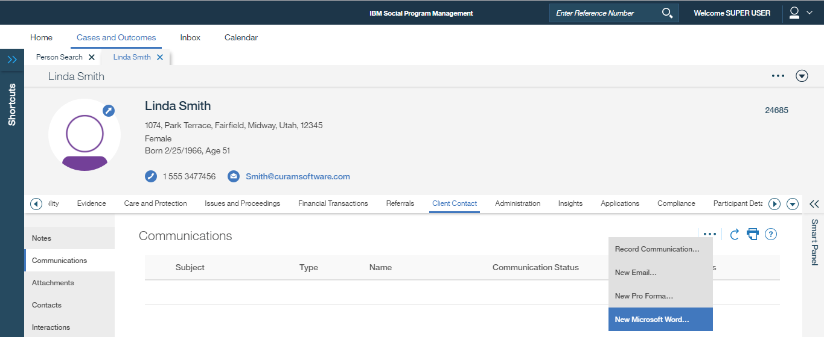
152269: As a caseworker, I need to be able to open, view and edit MS Word communications from Cúram Communications pages
152268: As a caseworker, I need the option to select an MS Word Document based on a template that I can edit
Use Case 1: Person, New Microsoft Word Communication
Person Page -> Client Contact -> Communications -> New Microsoft Word…

Slide 10
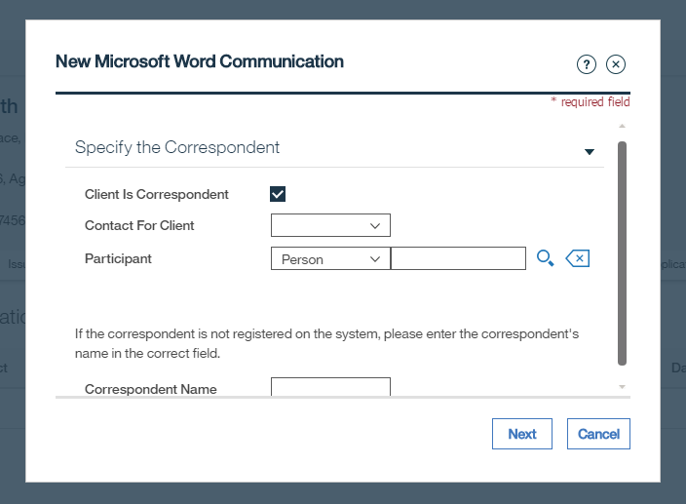
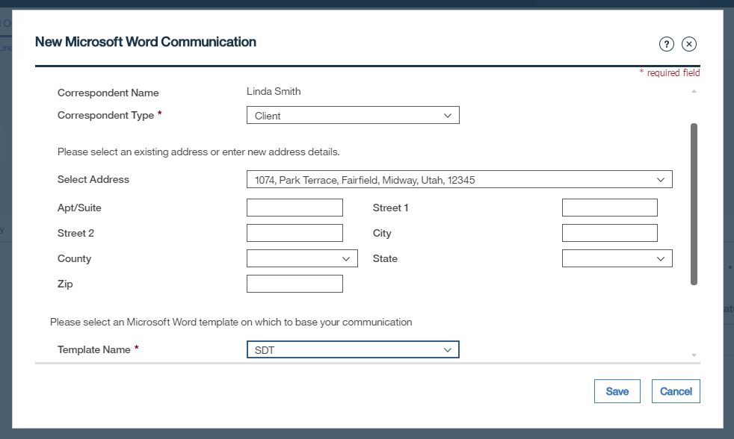
New Microsoft Word Communication Modals
Next ->
Note selection of Template meets requirement 152268
Save ->

Slide 11
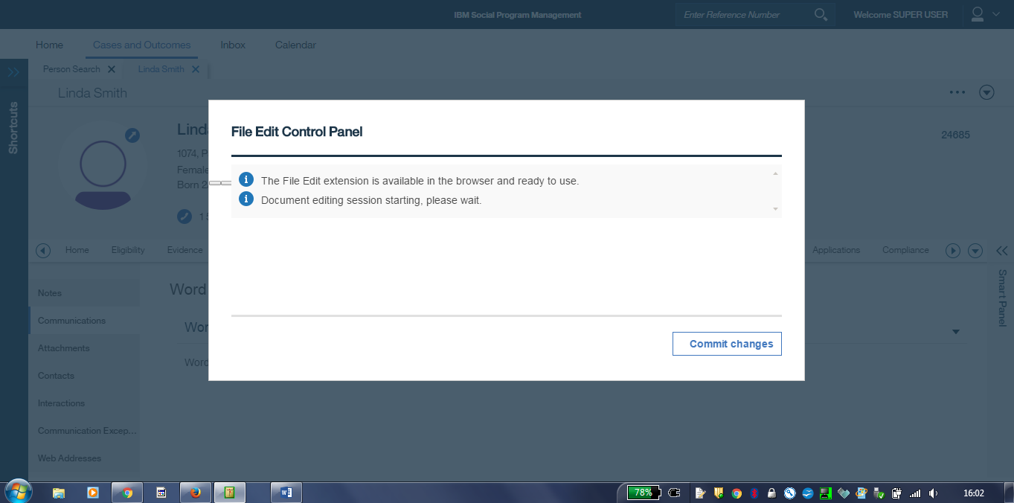
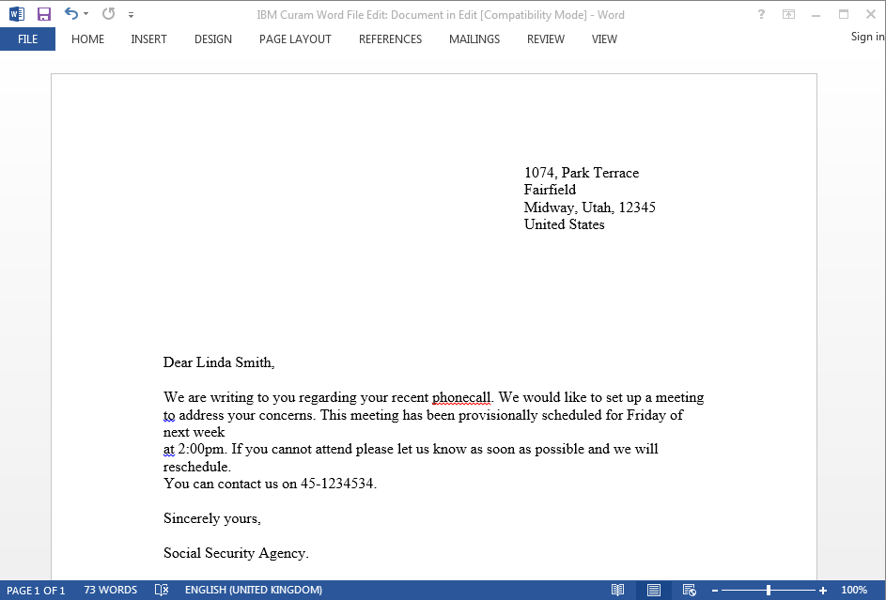
File Edit Control Panel and MS Word Open

Slide 12
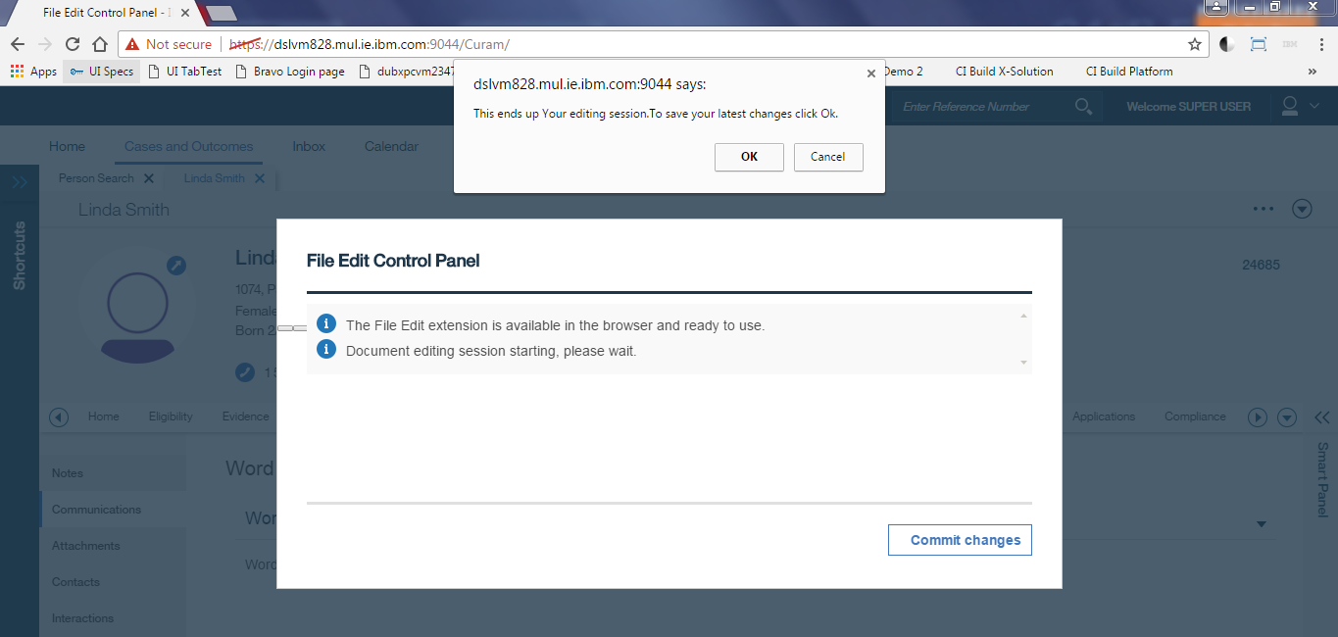
Edit and Close without saving in MS Word
OK ->

Slide 13
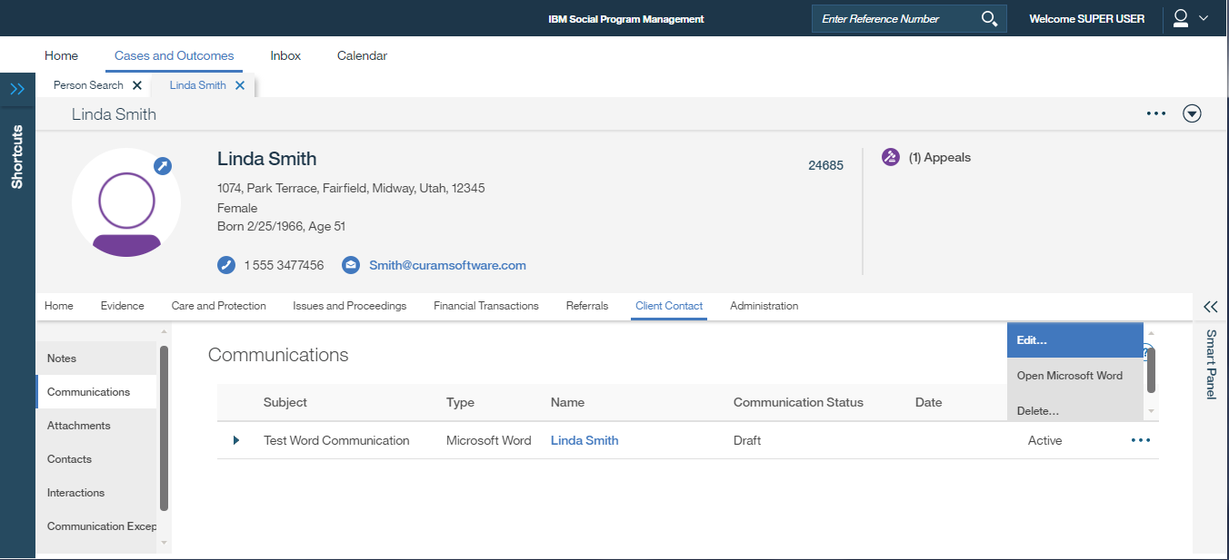
Recorded in Communications List
View, Edit and Delete row action menu options available

Slide 14
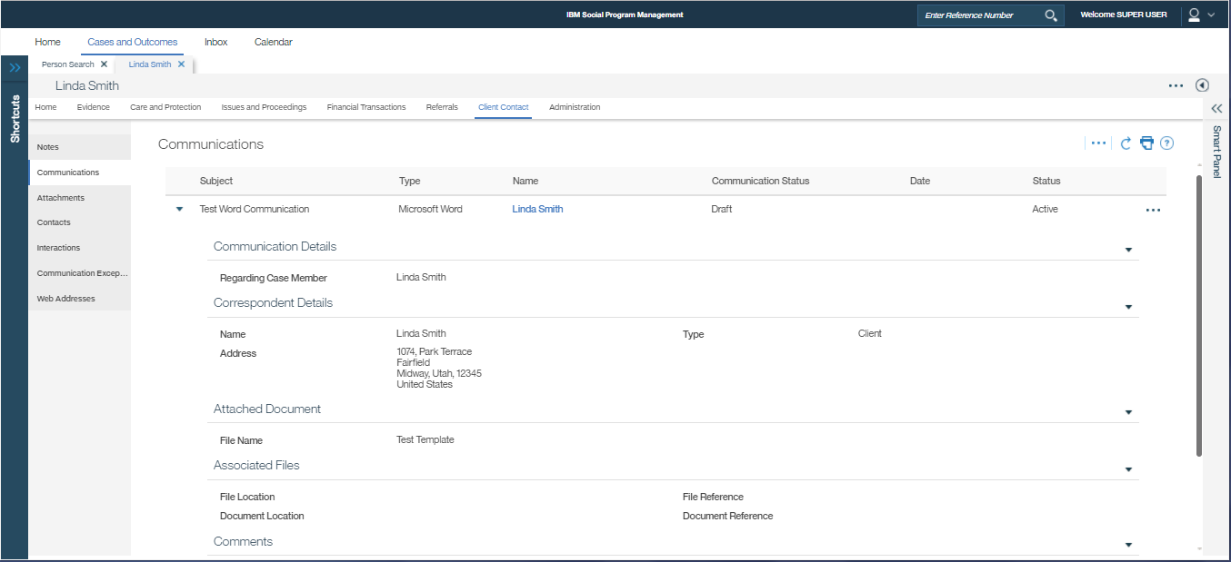
Communications List – Row Expanded
(Collapsed Context Panel and zoomed out to approx 70% to capture all content in 1 screenshot)

Slide 15
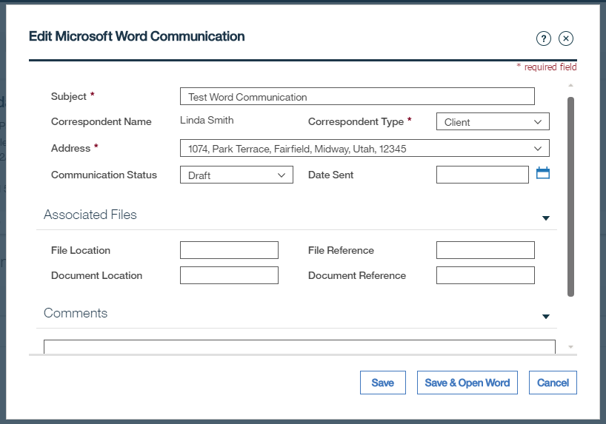
Select Row Action Menu -> Edit…
Edit details -> Save: Updates Communication Record. Does not update Word doc with changed details (e.g. Address) -> Goes back to Communications List
Edit details -> Save & Open Word: Updates Communication Record. Opens MS Word with updated details (e.g. Address)

Slide 16
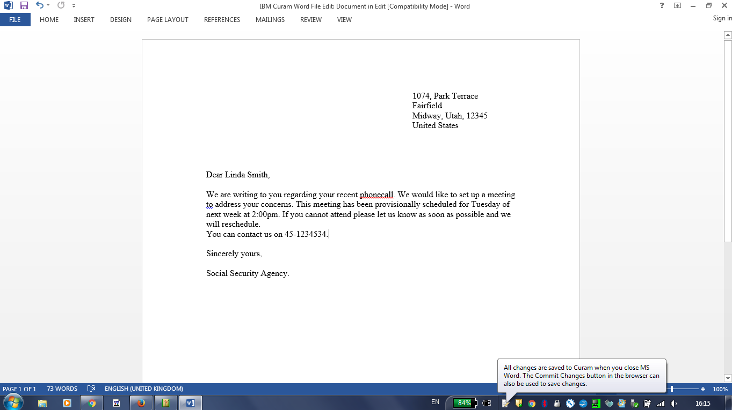
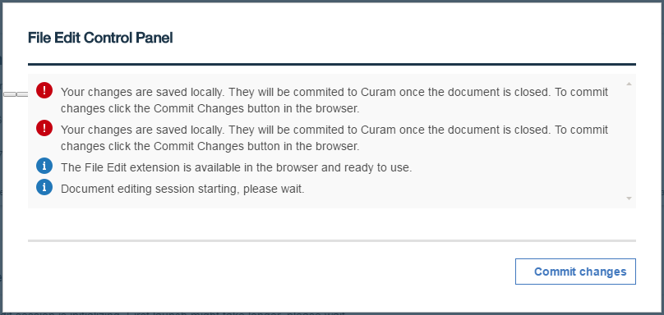
Edit then save in MS Word
Note the taskbar IBM Curam Word Integration Assistant message
… Also reflected in the File Edit Control Panel:

Slide 17
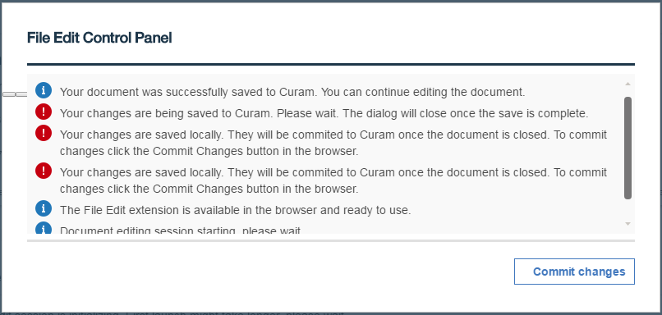
File Edit Control Panel -> Commit changes (while MS Word open)

Slide 18
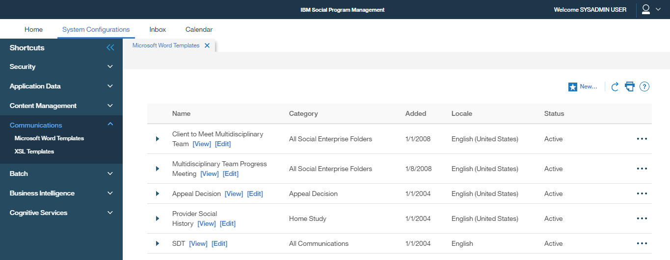
Use Case 2: Sysadmin, MS Word Template Management
Sysadmin login -> System Configurations -> Shortcuts -> Communications -> Microsoft Word Templates -> New…

Slide 19
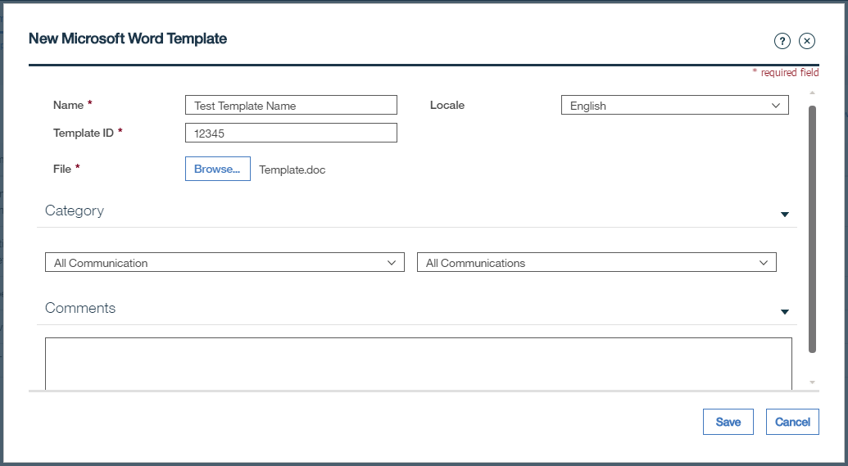
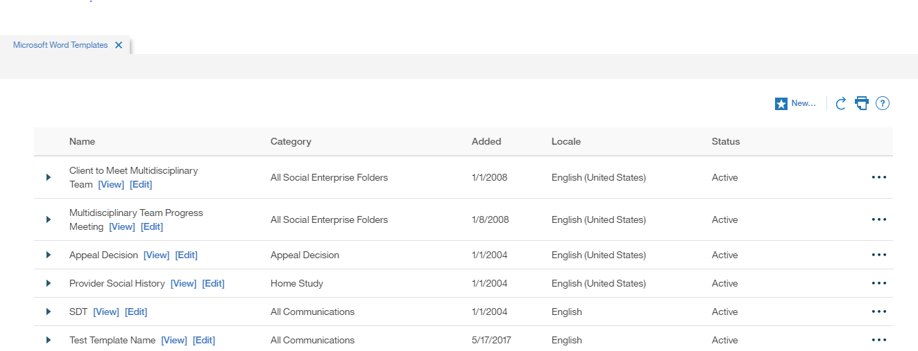
New Microsoft Word Template Modal
Save ->
New entry created in Microsoft Word Templates List

Slide 20
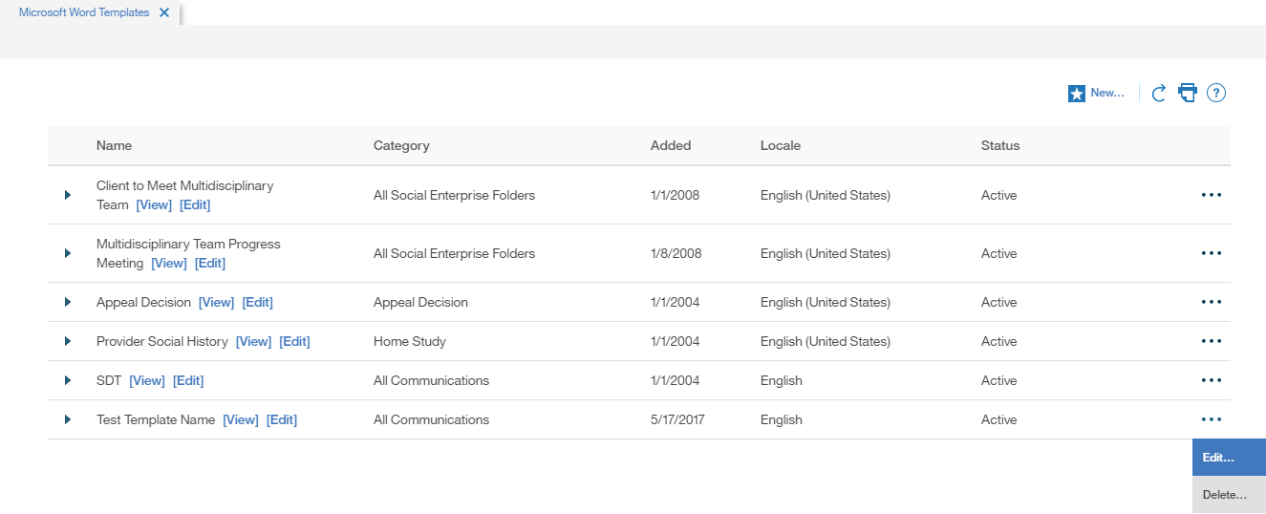
Microsoft Word Template can be Viewed, Edited and Deleted…

Slide 21
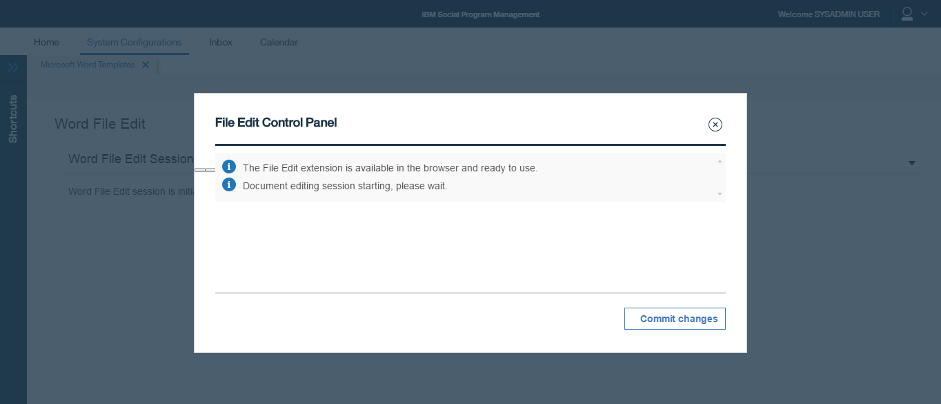
Select [Edit] -> Word File Edit Session is initializing… (Note this step does not work here in Chrome but does work in IE11, see slide 34 below)
Continue ->
… But no Word document opens, Defect?
Note this leaves the IBM Curam Word Integration Assistant on the taskbar and it is not possible to launch Word anywhere else again! Can only clear by logging out?

Slide 22
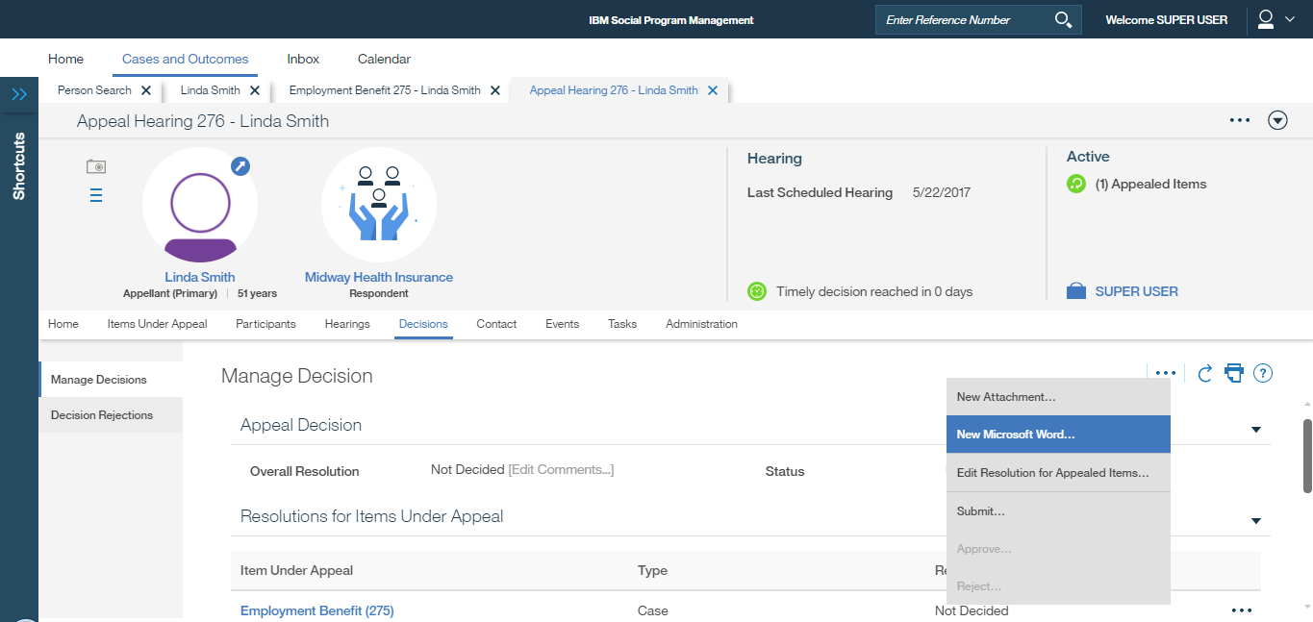
152275: As an Appeals user, I need to be able to search for pre-configured text that I can insert into a new MS Word template
Appeal Hearing -> Decisions -> Manage Decisions -> New Microsoft Word…

Slide 23
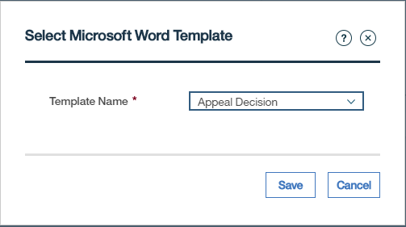
Select Microsoft Word Template Modal
Note selection of Template meets requirement 152268
Save ->

Slide 24
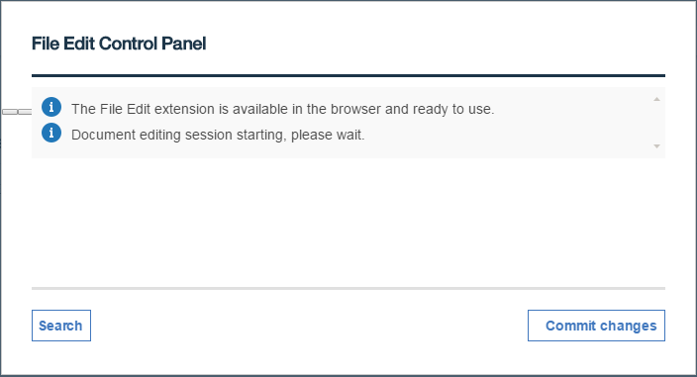
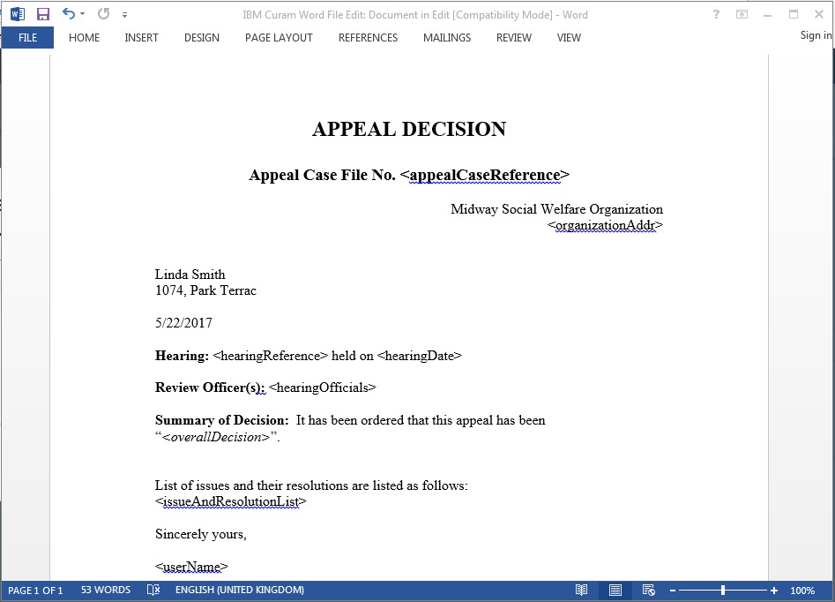
File Edit Control Panel with Search enabled and MS Word Open
Search ->

Slide 25
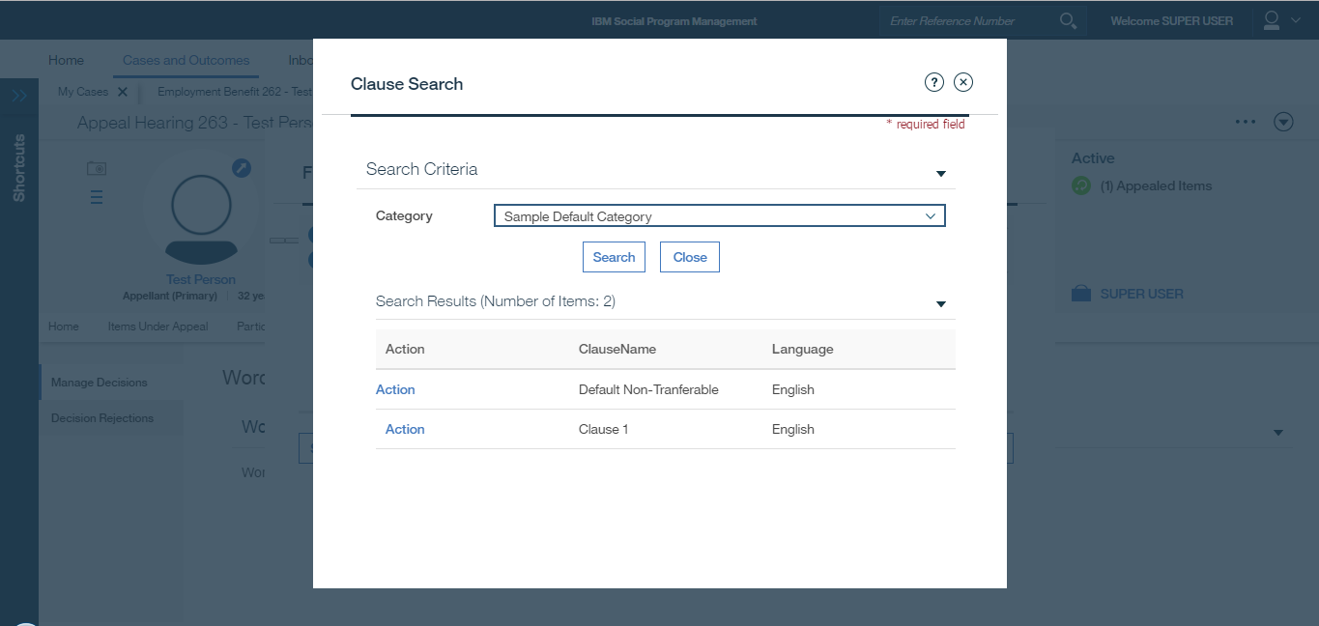
Appeals Clause Picker Modal
Select Category -> Search: Search Results List displays Appeals Clauses found

Slide 26
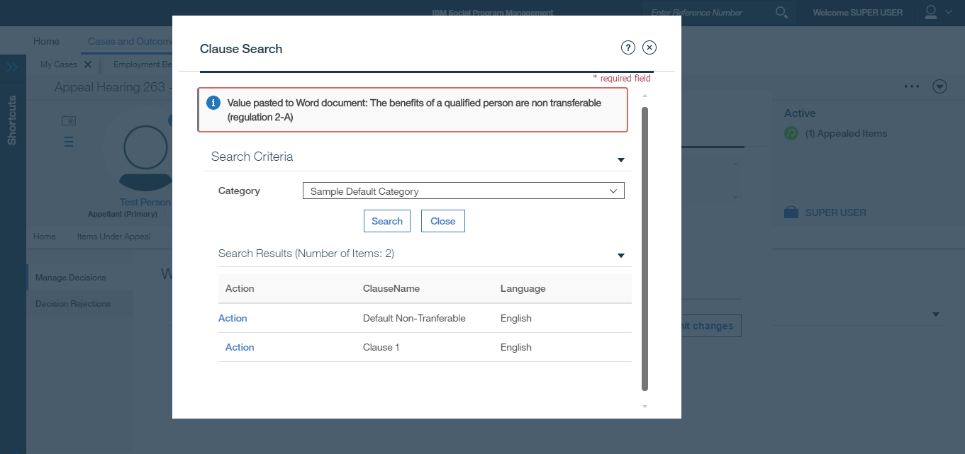
Appeals Clause Picker Modal, appeal clause paste
Action -> (selected clause is pasted into Word document at the location of the cursor)

Slide 27
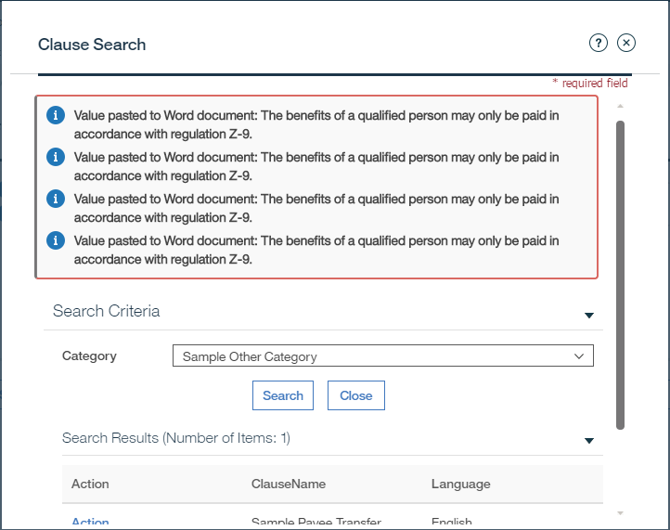
Appeals Clause Picker Modal, multiple pastes
Multiple Action -> (selected clauses are pasted into Word document at the location of the cursor)

Slide 28
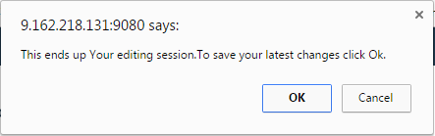
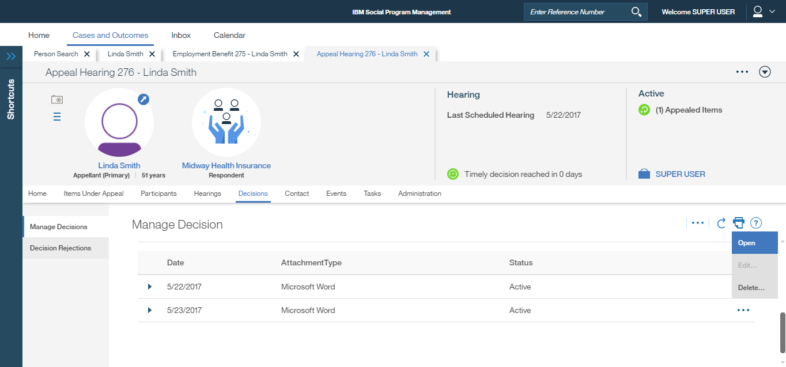
Edit and Close Word => End editing session modal then recorded in Manage Decision List
View, Edit and Delete options available

Slide 29
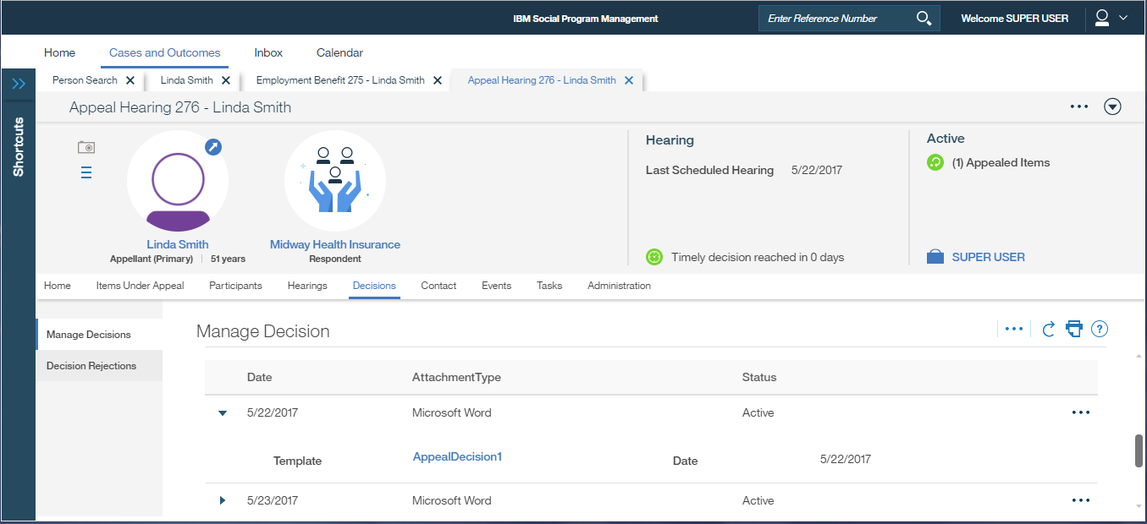
Manage Decision Row Expanded
Note Word document can be downloaded by clicking this link or by the ‘Open’ row action menu

Slide 30
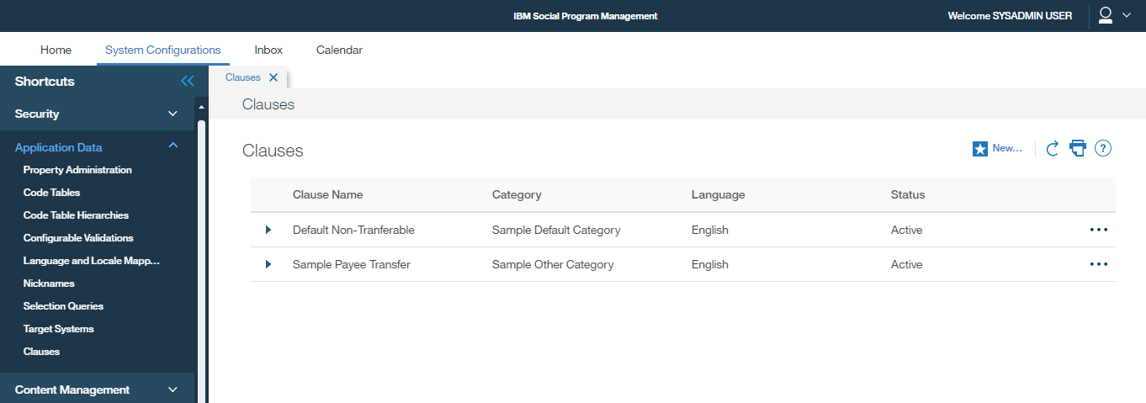
152276: As an Administrator, I need to be able to create standard paragraph text (clauses) that can be used to insert into an MS Word template
Sysadmin login -> System Configurations -> Application Data -> Clauses -> New…

Slide 31
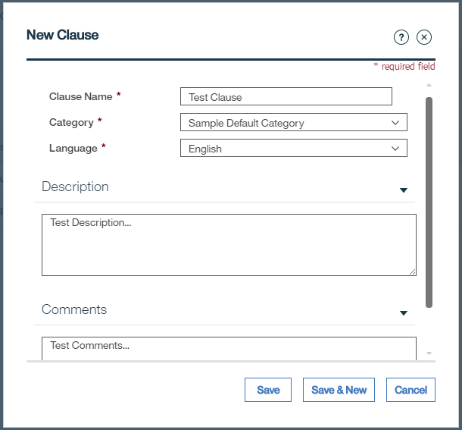
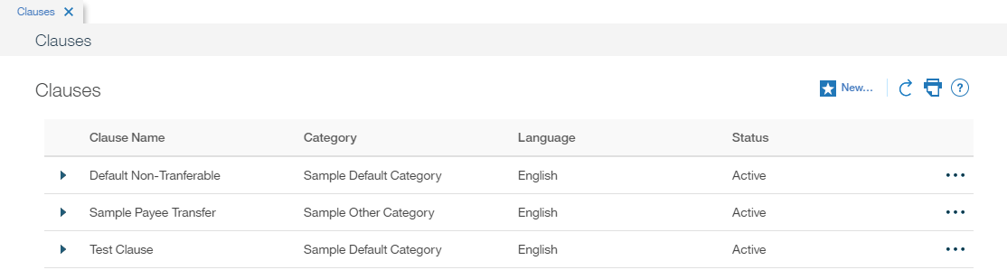
New Clause Modal
Save ->
New entry created in Clause List

Slide 32
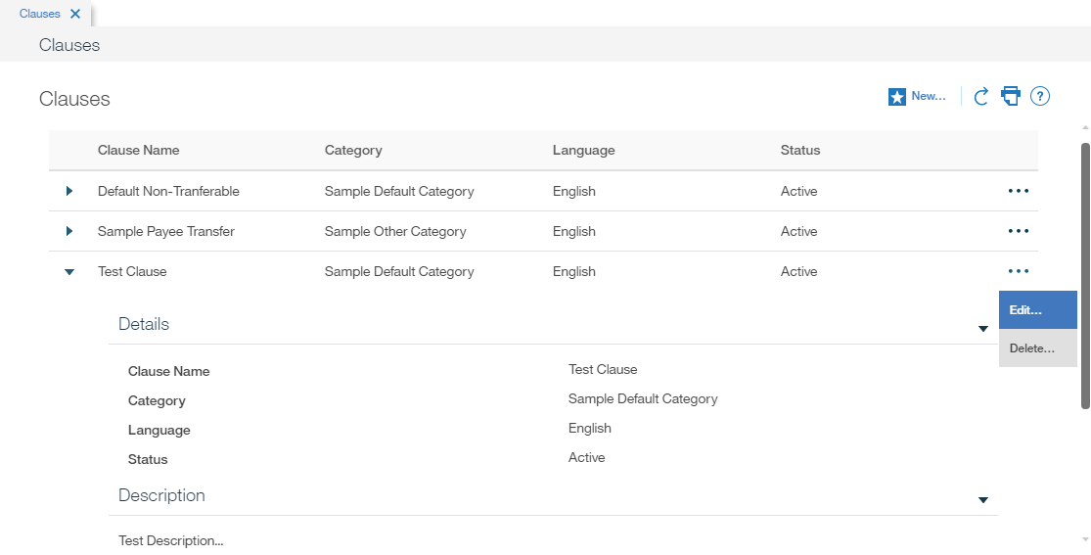
Clause can be Viewed, Edited and Deleted…

Slide 33
How Business Requirements satisfied today, 7.0.1 screenshots showing some IE11 Browser differences

Slide 34
152269: As a caseworker, I need to be able to open, view and edit MS Word communications from Cúram Communications pages
152268: As a caseworker, I need the option to select an MS Word Document based on a template that I can edit
Use Case 1: Person, New Microsoft Word Communication
Person Page -> Client Contact -> Communication -> New Microsoft Word…

Slide 35
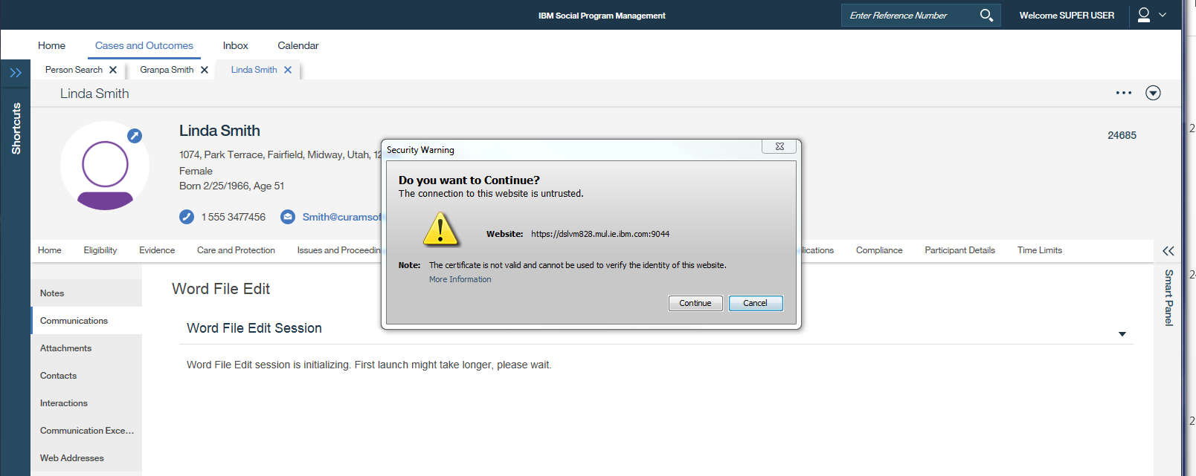
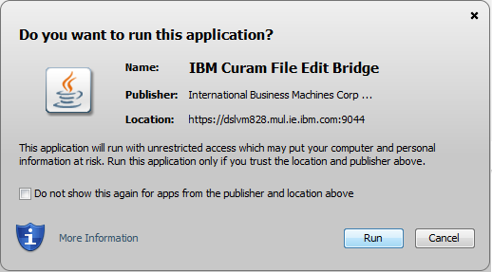

Word File Edit Session is initializing…
Continue ->
IBM Curam File Edit Bridge -> Run ->
JACOB : Java COM Bridge -> Run ->

Slide 36
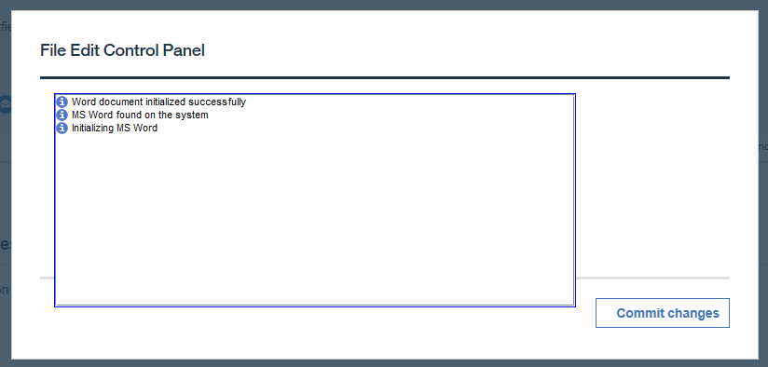
File Edit Control Panel and MS Word Open (Note notification panel larger than modal design)

Slide 37
Use Case 3: Sysadmin, MS Word Template Management
Sysadmin login -> System Configurations -> Shortcuts -> Communications -> Microsoft Word Templates -> New…

Slide 38
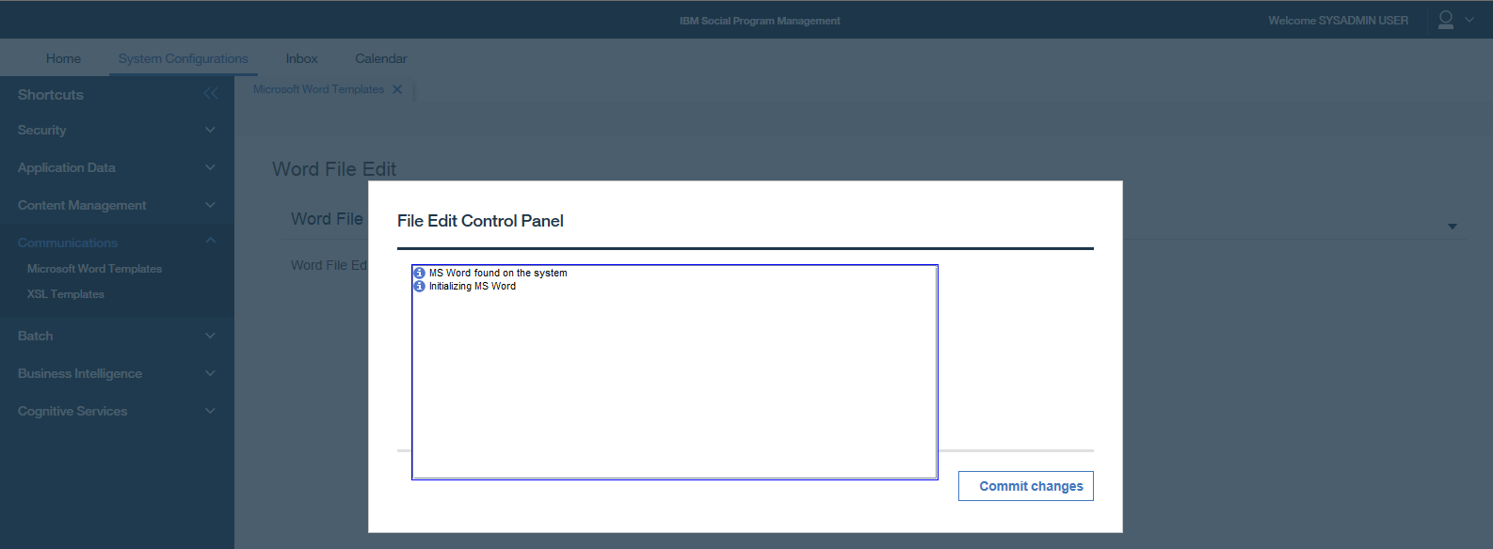
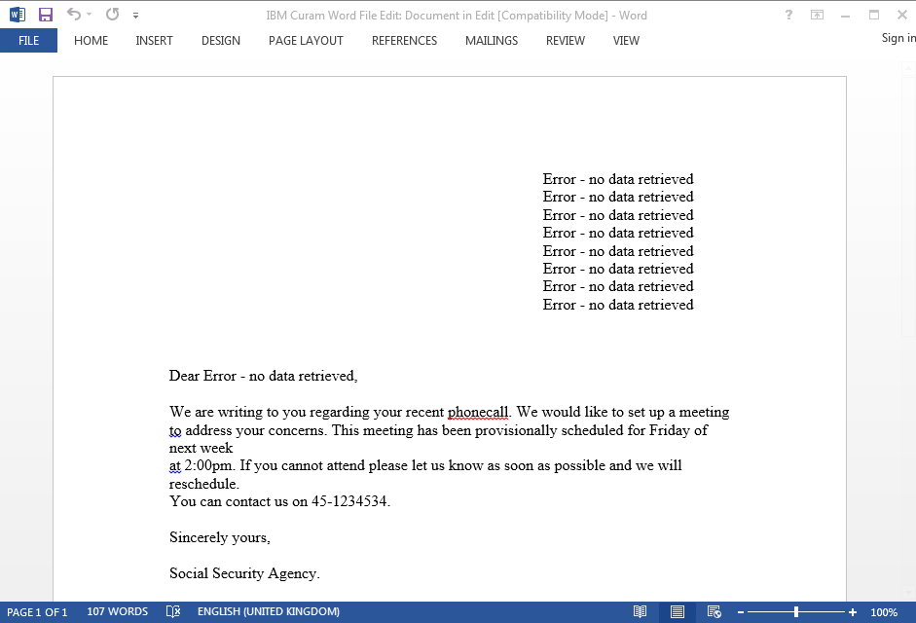
Select [Edit] -> File Edit Control Panel and MS Word Open (Note this step works in IE11 but did not work in Chrome)

Slide 39
How Business Requirements satisfied in future

Slide 40
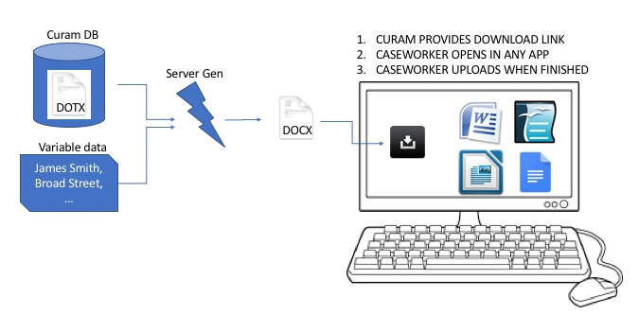
152269: As a caseworker, I need to be able to open, view and edit MS Word communications from Cúram Communications pages
Business Requirements
152268: As a caseworker, I need the option to select an MS Word Document based on a template that I can edit

Slide 41
Use Case 1: Person, New Microsoft Word Communication
Person Page -> Client Contact -> Communication -> New Microsoft Word…

Slide 42
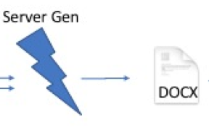
New Microsoft Word Communication Modals
Next ->
Note selection of Template meets requirement 152268
Save ->

Slide 43
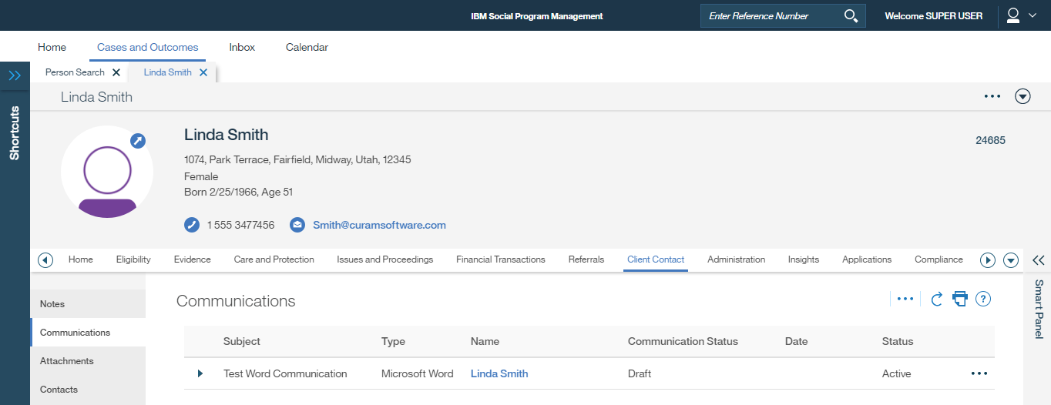
Saved to DB and recorded in Communication list

Slide 44



Edit, Upload New Version, Download, Delete
Row action menu options:
Edit…
Upload New Version Download
Delete

Slide 45
Row action menu -> Edit
No longer required
Edit details -> Save -> Closes Modal and goes back to Communications List. Edited details such as Address need to be also updated in Word doc

Slide 46
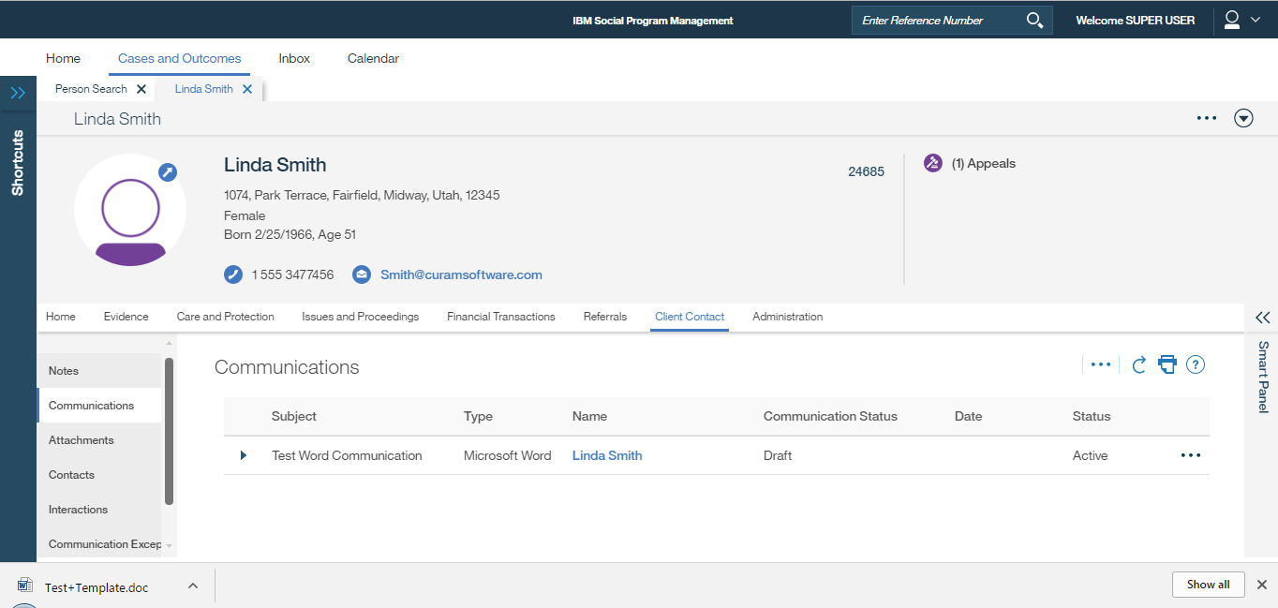
Row action menu -> Download
Standard Chrome Download notification on Windows, click to open Word document

Slide 47
Edit Word document and Save to local computer

Slide 48
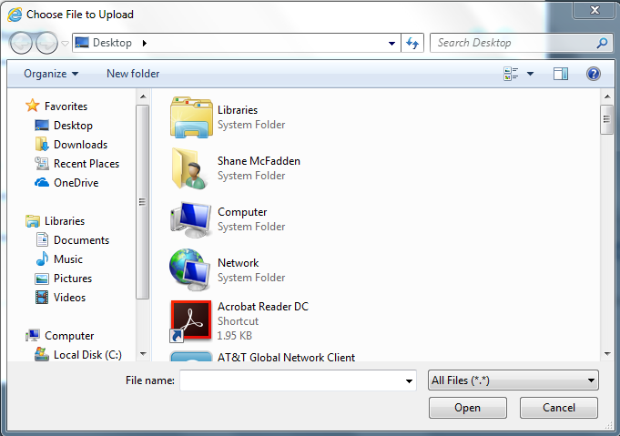
Row action menu -> Upload New Version
Use standard File Upload dialog to navigate to and upload the Word document that was just edited

Slide 49
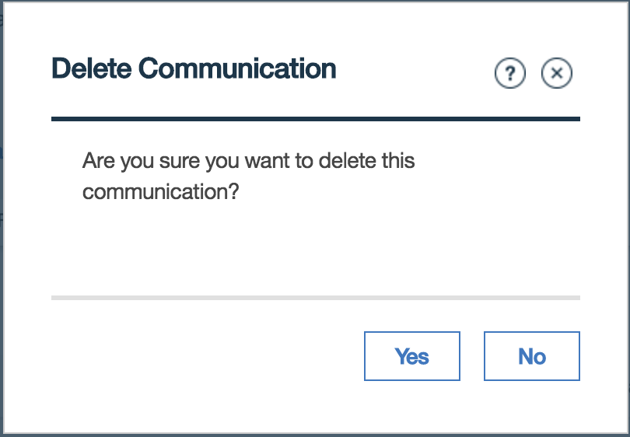
Row action menu -> Delete

Slide 50
152275: As an Appeals user, I need to be able to search for pre-configured text that I can insert into a new MS Word template
Appeal Hearing -> Decisions -> Manage Decisions -> New Microsoft Word…

Slide 51
Select Microsoft Word Template Modal
Note selection of Template also meets requirement 152268
Save ->

Slide 52
Saved to DB and recorded in Manage Decision List
These options will change to:
Edit, Download, Upload New Version, Clause Search, Delete

Slide 53
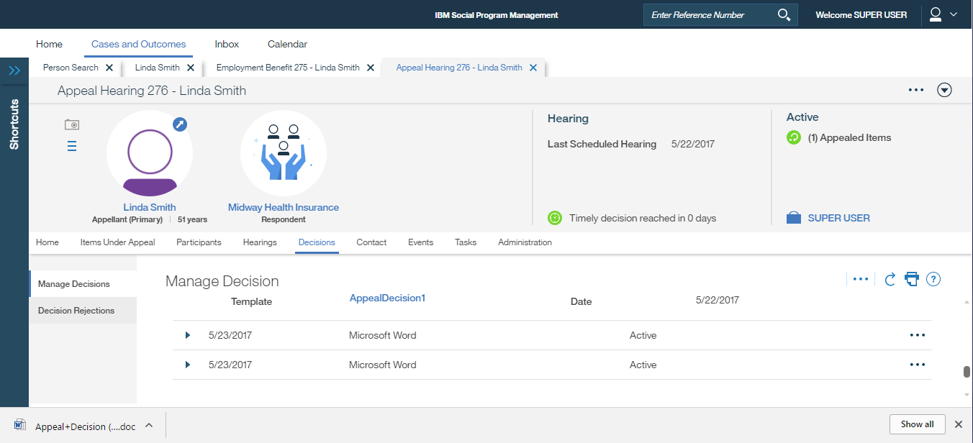
Download the Word document
1. Click to open in MS Word
2. Then select ’Clause Search’ from row action menu

Slide 54
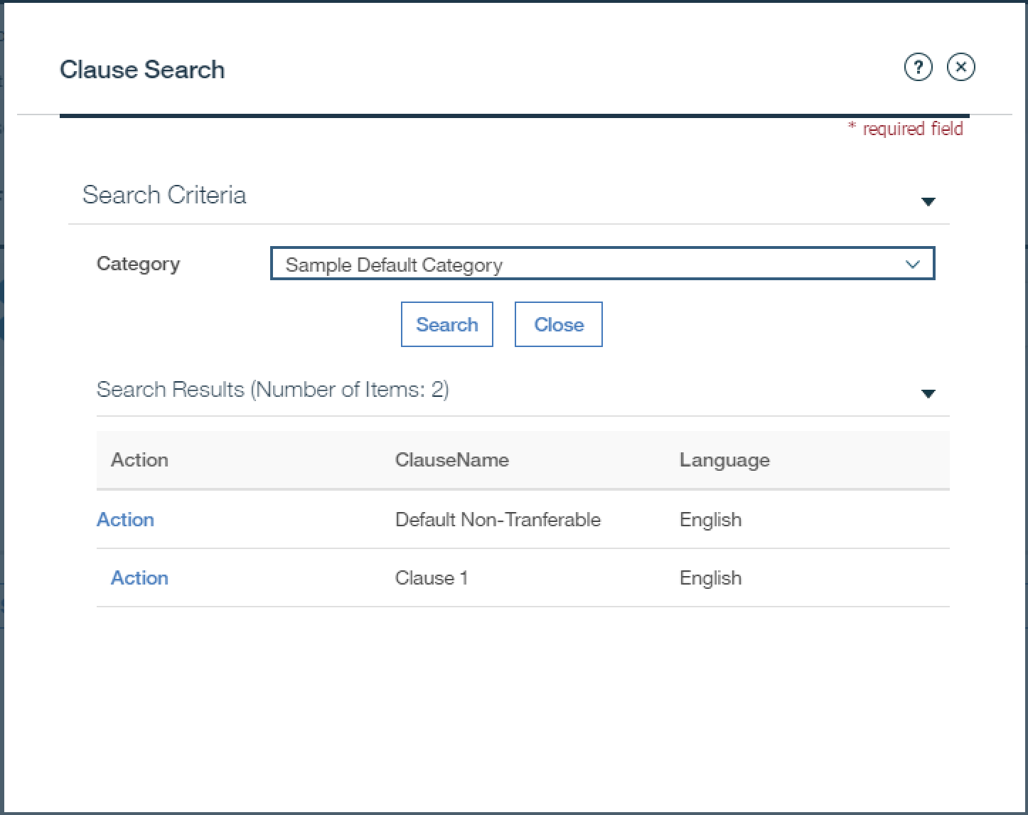
Appeals Clause picker and MS Word now open
Appeals clause in clipboard memory manually pasted at cursor location.
Save document to local computer when finished
Change labels to ‘Copy’ (selecting copies the appeals clause to OS clipboard)

Slide 55
Upload New Version
2. Use standard File Upload dialog to navigate to and upload the Word document that was just edited
1. Select Row action menu -> Upload New Version

Slide 56
152276: As an Administrator, I need to be able to create standard paragraph text (clauses) that can be used to insert into an MS Word template
Sysadmin login -> System Configurations -> Application Data -> Clauses -> New…
Same as before => No impact

